Slide 1


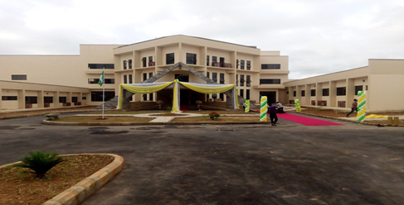
SHESTCO
.
.
.

Slide 2

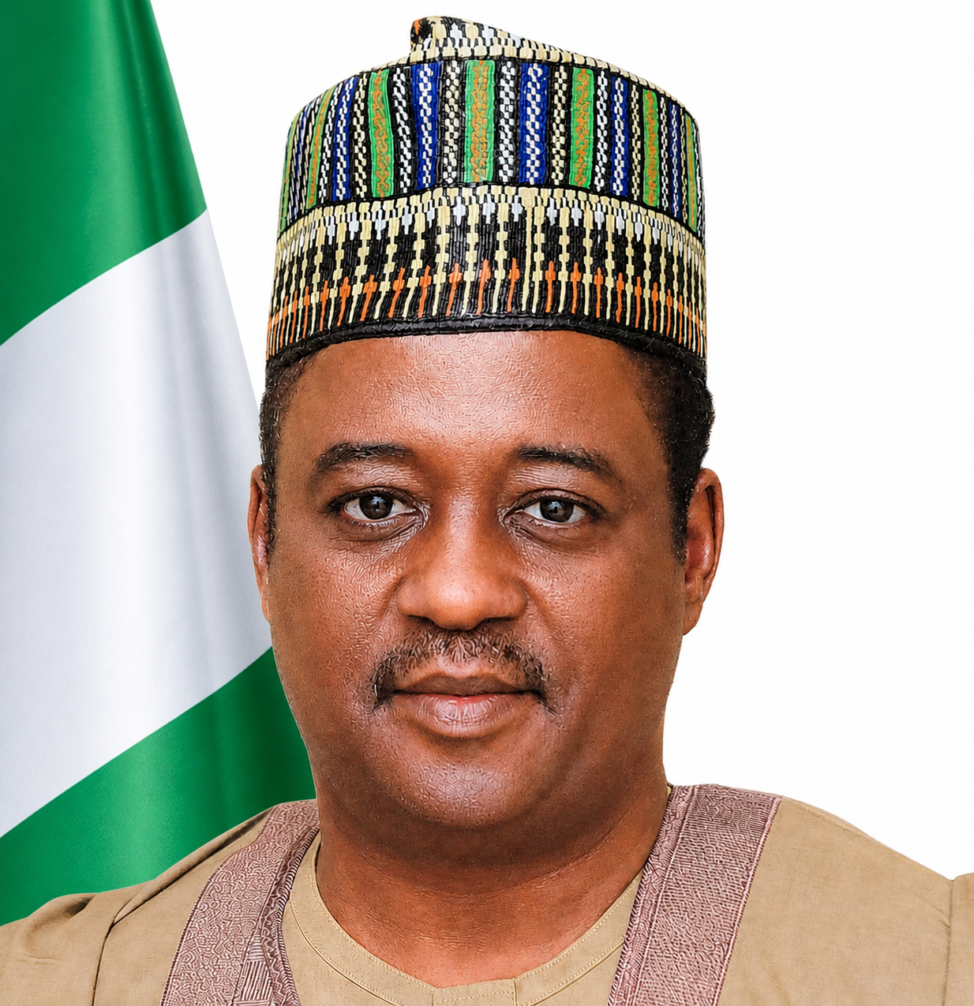
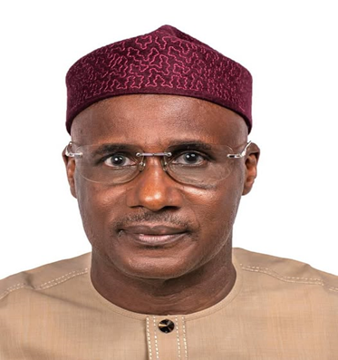
.
.
.
Dr. Kingsley Tochukwu Udeh SAN
Dr. Mukhtar Yawale Muhammad, MFR, mni
Hon.(Engr) Magaji Da’u Aliyu, PhD, mni
Dr. Kingsley Tochukwu Udeh SAN
Dr. Mukhtar Yawale Muhammad, MFR, mni

Slide 3
BRIEFING TO THE PERMANENT SECRETARY
FEDERAL MINISTRY OF INNOVATION SCIENCE AND TECHNOLOGY
.
BY
.
.
Hon.(Engr) Magaji Da’u Aliyu, PhD, mni
DIRECTOR GENERAL/CEO
SHESTCO

Slide 4
PREAMBLE
Sheda Science and Technology Complex (SHESTCO) is a parastatal under the aegis of the Federal Ministry of Innovation, Science and Technology.
SHESTCO was established by the Act CAP. S5 (formerly decree No. 95 of 1993) as a multi-disciplinary Research and Development Complex.
The Complex was designed for the purpose of enabling Institutions and individuals to undertake a wide range of research and development in a comprehensive and organized manner.
.
.
.
.

Slide 5
MISSION STATEMENT
To Provide High-tech Research Facilities for Basic and Applied Sciences for the STI ecosystem, and process research results for application in the areas of Agriculture, Health, Industry, and the Environment.

Slide 6
VISION STATEMENT
To provide a platform for the application of high technology research outcomes for the improvement of the standard of living of Nigerians, ensure a healthy environment, encourage effective collaboration and information sharing, and promote innovation for enhanced industrial competitiveness, growth, and sustainability.

Slide 7
MANDATE OF THE COMPLEX
Provide a platform for the effective application of Science and Technology in Nigeria;
Conduct advanced research and development to strengthen the nation’s technological and economic growth through innovation and commercialization;
Operate specialized facilities, including nuclear research infrastructure, to support agriculture, medicine, industry, and basic sciences.;
Promote scientific information management and collaboration through accessible Science and Technology databases.
.
.
.

Slide 8
MANDATE OF THE COMPLEX
Undertake research in conventional and alternative energy technologies;
Provide structured manpower training in high technology fields to meet national development needs;
Support institutions of higher learning by providing access to cost-effective facilities for capital-intensive research.
.
.
.

Slide 9

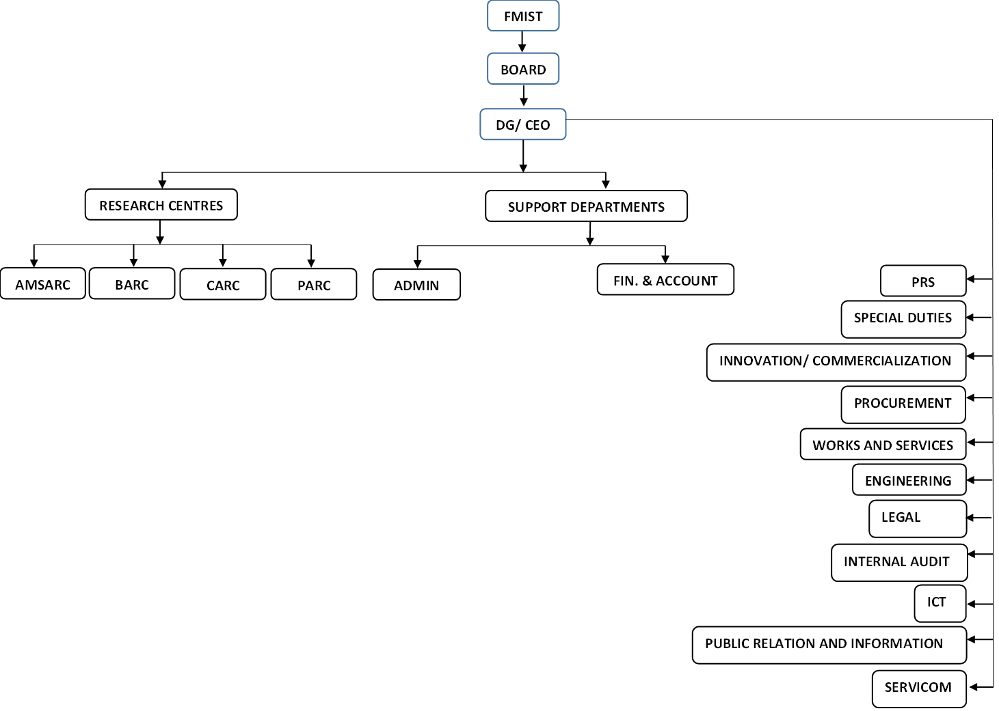
.
.
.
.

Slide 10
STAFF STRENGTH
The total staff strength of the Complex is 356
Researchers - 153
Engineers/Technologists - 55
Non-Researchers - 148
.
.
.

Slide 11
RESEARCH STAFF
Qualifications: Researchers
Ph.D.: 34
M.Sc.: 31
B.Sc.: 88
.
.
.

Slide 12
RESEARCH CENTRES
Applied Mathematics and Simulation Advanced Research Centre (AMSARC)
Biotechnology Advanced Research Centre (BARC)
Chemistry Advanced Research Centre (CARC)
Physics Advanced Research Centre (PARC)
Engineering Department (ED)
.
.
.

Slide 13
SHESTCO FRAMEWORK
The operations of the Complex are carried out through
i. Four (4) major Advanced Research Centres,
ii. Central Engineering Workshops
iii. Nuclear Technology Centre (NTC)
Other Support Departments are: Works and Services. Human Resources, F/Accounts, Procurement, Legal, ICT, and PRS.
.
.
.

Slide 14
SHESTCO RESEARCH ACHIEVEMENTS
.
.
.

Slide 15
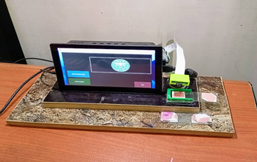
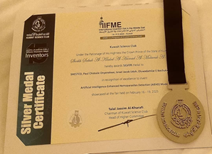
DESIGN AND DEVELOPMENT OF AI – ENHANCED HOMEOPARASITE DETECTION MODEL
(PATENTED & AWARD-WINNING)
Design and Development of an Automated Malaria/Typhoid Parasite Detection Device.
.
.

Slide 16
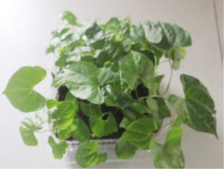
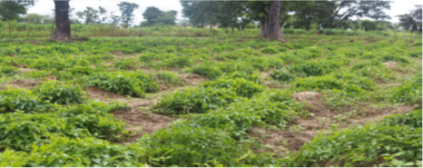
HYBRID CROP MULTIPLICATION
Production of Ginger Callus Phenol.
Regeneration of Rice, Wheat, and Cassava from Callus Cells for Plant Transformation.
Production of varieties of yam seeds through hydroponics
.
.
.
Cultivation of developed plantlets

Slide 17
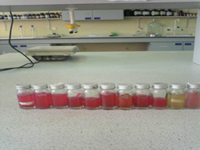
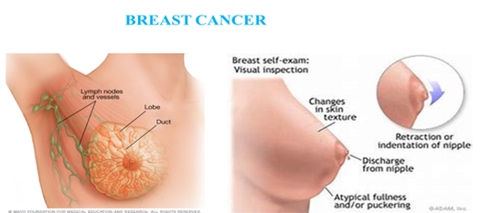
NOVEL PATHWAY TO ANTI-CANCER COMPOUND PRODIGIOSIN
Develop a targeted treatment of breast cancer using Prodigiosin from a specific bacterium.
The target system is undergoing testing using breast cancer cells under laboratory conditions.
.
.
.
Prodigiosin for the treatment of breast cancer: the processes involved at the level of the cancer cell

Slide 18
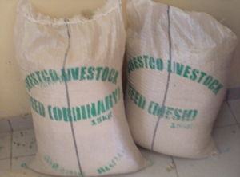
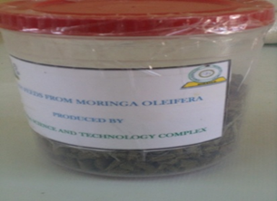
AGRO-BOOSTER FROM MORINGA
Production of Plant growth hormone from Moringa capable of boosting crop yield and Moringa fortified livestock feed for poultry, rabbits, cattle, and aquaculture.
.
.
.

Slide 19
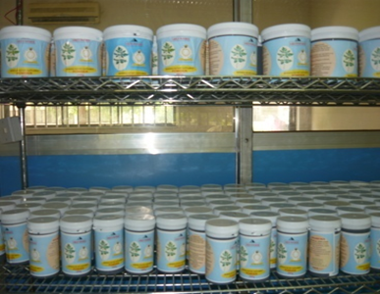
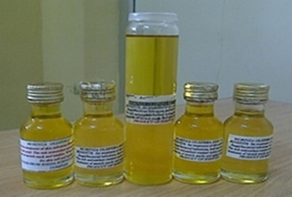
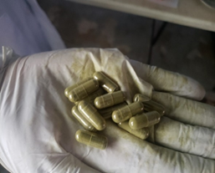
MORINGA OLEIFERA LEAF POWDER,OIL, AND CAPSULES FOR COMMERCIALIZATION
Value Addition for Moringa products processed through good agricultural practice (GAP) and good Manufacturing Practice (GMP).
.
.
.
Cross-section of Moringa Powder (food supplement) Processing unit at SHESTCO, FMST
SHESTCO Produced Moringa oil
SHESTCO Moringa Capsule

Slide 20
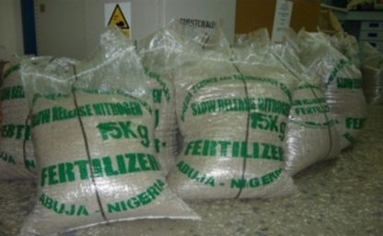
SLOW-RELEASE NITROGEN FERTILIZER
Production of slow -release fertilizer for a one-off application.
.
.
.
Slow-release nitrogen fertilizer made from
maize cobs and urea.

Slide 21
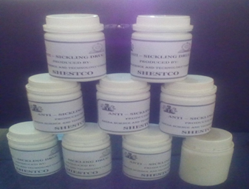
DEVELOPMENT OF ANTI-SICKLING PHYTO DRUG
Production of a Plant-based drug for sickle cell disease management.
Clinical trials and NAFDAC listing of this drug are being awaited.
.
.
.
Anti-sickling Phyto drug capsules

Slide 22
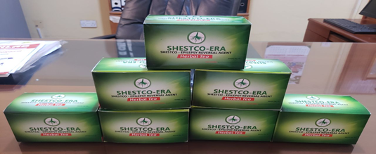
DEVELOPMENT OF ANTI-EPILEPSY PHYTO DRUG
Development of a plant-based therapeutic agent for the reversal of epilepsy.
Clinical trials and NAFDAC listing for this drug are pending.
.
.
.

Slide 23
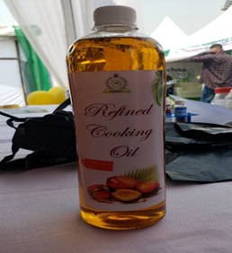
PROCESSED SATURATED FATTY ACID FREE PALM OIL
.
Value addition and conversion of palm oil to free from saturated fatty acids vegetable oil with vitamins
.
.

Slide 24
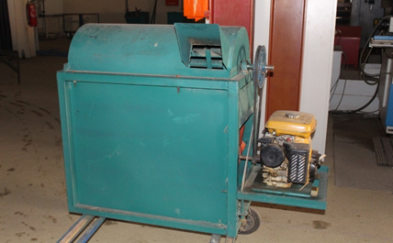
AGRO-PROCESSING MACHINES
Design and fabrication of a threshing machine.
.
.
.
FABRICATION OF THRESHING MACHINE

Slide 25
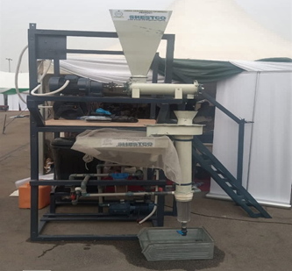
AGRO-PROCESSING MACHINES
.
Fabrication of an Acha de-sanding machine.
The machine employs the floatation method for separation.
.
.
Acha de-sanding machine
FABRICATION OF RICE THRESHING MACHINE

Slide 26
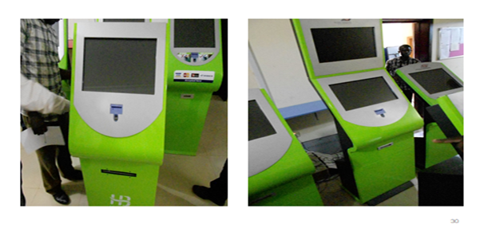
POINT OF SERVICE (POS) CHASSIS AS IMPORT SUBSTITUTE
Design and fabrication of POS chassis for ticketing, data capture, etc in collaboration with Access Solution LTD.
.
.
.
Different model of POS Kiosk

Slide 27
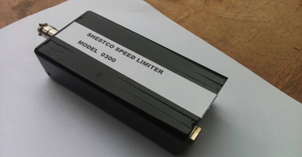
VEHICLE SPEED LIMITER
Design and fabrication of a prototype electronic vehicle speed limiter (4 versions of the device developed).
.
.
.
SHESTCO Vehicle Speed Limiter

Slide 28
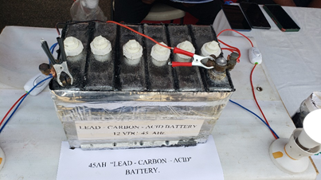
LEAD-ACID BATTERY
Design and Development of a lead-acid (12V 150AH) capacity battery with unserviceable batteries and lead ore.
.
.
.

Slide 29
STAKEHOLDERS ENGAGEMENT
MOUs for Technical collaborations with governmental, non-governmental, and international organizations have been signed. These includes:
Private Companies - 6
Federal Universities - 3
State Universities - 3
Private University - 1
PTDF professorial chair of the chemical engineering department, Ahmadu Bello University, Zaria
Federal Ministry of Environment, through the environmentally sound management and disposal of polychlorinated biphenyl(PCB) project (ESMDP), Abuja.
Nigerian Armed Forces
Niger delta Science, Technology and Bio-Enterprise development limited, Abuja
Eco Lumens International Limited Abuja
.
.
.

Slide 30
CHALLENGES
We face major operational challenges arising from Obsolete equipment, poor power supply, inadequate funding, and the high cost of maintaining advanced scientific infrastructure.
We are confronted with weak commercialization pathways, limited industry linkages, rapid technological obsolescence, and insufficient investment in research modernization, which restrict the effective utilization of its scientific innovations and facilities.
Increasing brain drain and difficulties in retaining highly skilled researchers and technologists threaten institutional sustainability, operational efficiency, and SHESTCO’s long-term competitiveness within the national and regional innovation ecosystem.
.
.
.
.

Slide 31
POSSIBLE SOLUTIONS
Operational and institutional challenges can be addressed through strategic investment in alternative energy systems, sustainable funding mechanisms, infrastructure modernization and the establishment of robust commercialization and technology transfer frameworks.
Staff retention through improved welfare, performance-based incentives, continuous capacity development, and policies that encourage innovation, while promoting local content research to reduce dependence on imported scientific inputs.
Expanding consultancy services, industrial partnerships, mechanized agriculture and international collaborations will enhance revenue generation, attract global research funding and position SHESTCO as a leading regional hub for science, technology and innovation.
.
.
.
.

Slide 32
THANK YOU FOR YOUR
TIME AND ATTENTION
.
.
.
.

